Slide 1
Towards 4th Industrial Revolution: Perspective and Our Opportunities
Abu Jubayer, Managing Director
Sustainable Research and Consultancy Ltd. (SRCL)
28, Kawran Bazar, Dhaka-1205. M: +88 01711 459532
E: Jubayer.buet.bd@gmail.com W: www.srclgroup.com

Slide 2
Chronology of Industrial Development

Slide 4
Basic Technologies for 4IR

Slide 5
IMPACT : Where and How?

Slide 7
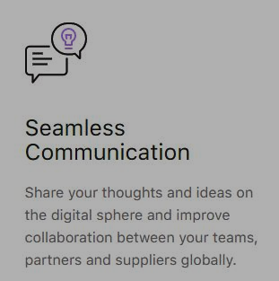
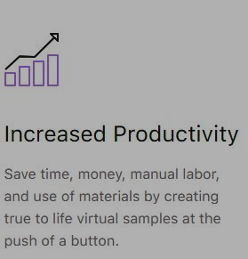
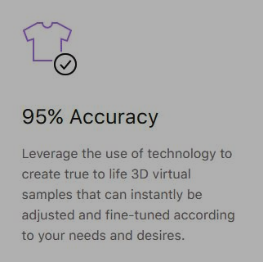
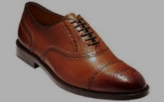
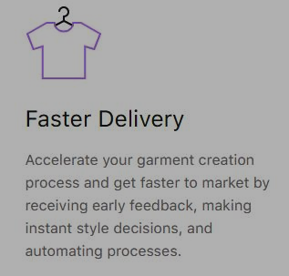
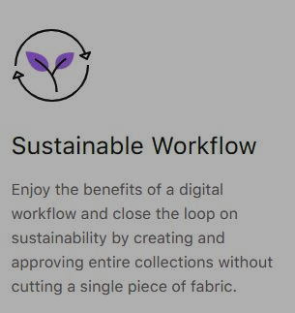

Requirements in Leather Sector

Slide 8

Our Future Target (Skilled Manpower Preparation)
Upscaling & Improve Management Skills
Reskilled Worker Development & Mentorship
Develop Technical & Specialized Skills Training Program

Slide 9

Training Program For Mid Level and Senior Management in leather Sectors
Online Trainings for Midlevel Management

Slide 10

Advance Level Training

Slide 11

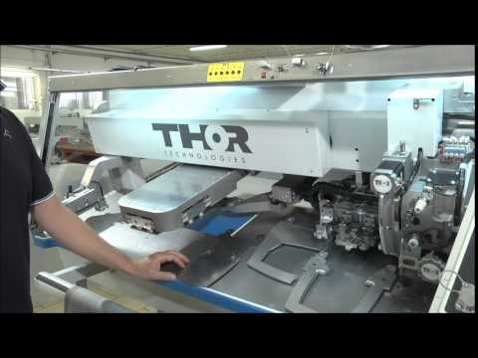
Advance Level Training for Auto Worker Development
3D Model Presentation for Buyer
3D Automated Cutting Bangladesh

Slide 12
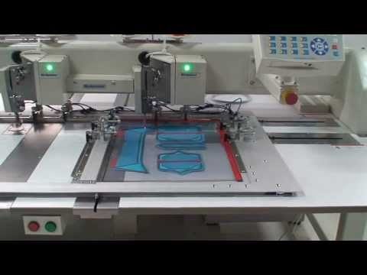
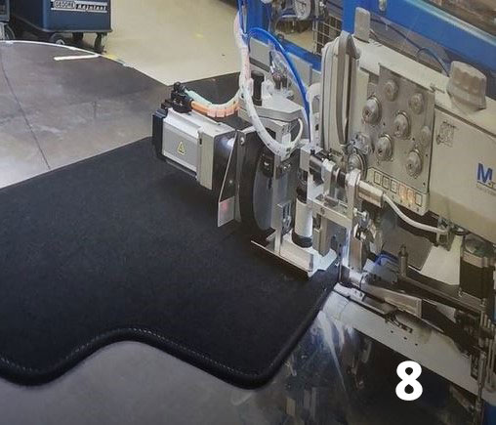

Progress in Vietnam and Other Countries
3D Model Presentation for Buyer
Automated Voice Control Sewing Machine
Automated Leather Processing with Tracing

Slide 13
Top 10 Largest Leather Importers and Exporters
Rank | Country | 2019 Import Value (US$ million)
1 | Italy | 2,413.6
2 | China | 967
3 | Mexico | 772.3
4 | USA | 603.5
5 | Romania | 442.7
6 | Portugal | 418.7
7 | Poland | 388.7
8 | South Korea | 385.1
9 | Hungary | 238.1
10 | Japan | 192.9
Rank | Country | 2019 Export Value (US$ million)
1 | Italy | 3,819.8
2 | USA | 1,700.4
3 | China | 909.1
4 | South Korea | 509.5
5 | UK | 338.2
6 | Mexico | 316.9
7 | Poland | 269
8 | Pakistan | 228
9 | New Zealand | 179
10 | Canada | 159.8

Slide 14
Basic Team Members
Sl. No. | Name | Qualification (Basic Education) | Relevant Experience (Year)
01 | Dr. Md. Mazedul Haque | PhD, Netherland | 18
02 | Dr. Sayed Md. Nazim Uddin | PhD, Canada | 13
03 | Dr. Razib Amirul Islam | PhD, Canada | 12
04 | Dr. Zahanara Parvin | PhD, Japan | 12
05 | Abu Jubayer | M. Sc. (BUET) | 12
06 | Sadequr Rahman | M. Sc. (BUET) | 10
07 | Emdad Ali | M. Sc. (JU) | 18
08 | Jinnat Ara Khatun | M. ED (DU) | 14
09 | Mehedi Hassan | M. S. S. (DU), IT | 10
10 | Nazmul Hassan | B. SC. In CSE, (UAP), IT | 8
11 | Sanjida Rahman | B. SC. In CSE, (CUET), IT | 8
12 | Tanvir Rahman | B. SC. In CSE, (CUET), IT | 5
13 | Salim Ahmed | B. SC. In CSE, (BUET), IT | 5
14 | IT Support Technician (6) | Various | Various
15 | Office Staff (7) | Various | Various

Slide 15
Tentative Funding Sources
Different Ministry Project (Labor Ministry, PM Office, ICT, A2I and others)
Bank Fund for Green Project Development
Foreign Investment in Leather Sector
World Bank Running Project
World Bank Upcoming Project
ADB Running Project
ADB Upcoming Project
EU Running Project
NSDA Running and Upcoming Project
ILO and Other UN Organization Projects
Chamber of Commerce Projects
Others

Slide 16
Our Basic Activities
Project Procurement
Project Conceptualization
Concept Note preparation
Donor Agencies and Ministry Proposal Preparation
File Processing
Fund Allocation
Banking Fund Management
Green fund Management
Project Implementation
International Training Arrangement
Master ToT Preparation
Field Training Implementation
Online Training Program Arrangement (Classroom and Trainer Module)
Cloud Based Hands on Training Program
Procurement and Setup advance level technologies for factories
Run Online based market for leather sectors

Slide 17
Benefits of Leather Trade Organization (TO)
More International Buyers and More Export
Demand of Era and Change
Different Loan & Green Fund
Skill development, SME improvement & other relevant projects
Advance Level Mass Production in House
Advance for 4IR activities which Must Come
Compete International Market in Advance
New Bank Loan for Members
International Project Fund Gain
Skilled Manpower Development for Factories
New start for committee
Acceptance to Honorable Prime Minister, People Republic of Bangladesh
National and International Reputation
Start a new concept for All Members
Benefit in the long run

Slide 18
Benefits of SRCL
Improve the Advance level of Training program in Bangladesh
Become a New Entrepreneur for 4IR & relevant sector in industry
Advance Technological Development for Skilled Sector and Become pioneer
General Consultancy Fees from this project Procurement
Service Charges from different loan or green fund management
General remuneration from project management

Slide 19
Why Choose Us?
Bangladesh Govt. Registered Company for Consultancy (Incorporation, TIN, VAT and Trade License)
National and International Experienced Team members
International Trainer Pool (Australia, Singapore, Sri Lanka, India and Japan)
Improved Online Training Facilities
Different Running Training Projects (www.socheton.com )
Relevant with different ministry of Government and other Donor Organization.

Slide 20
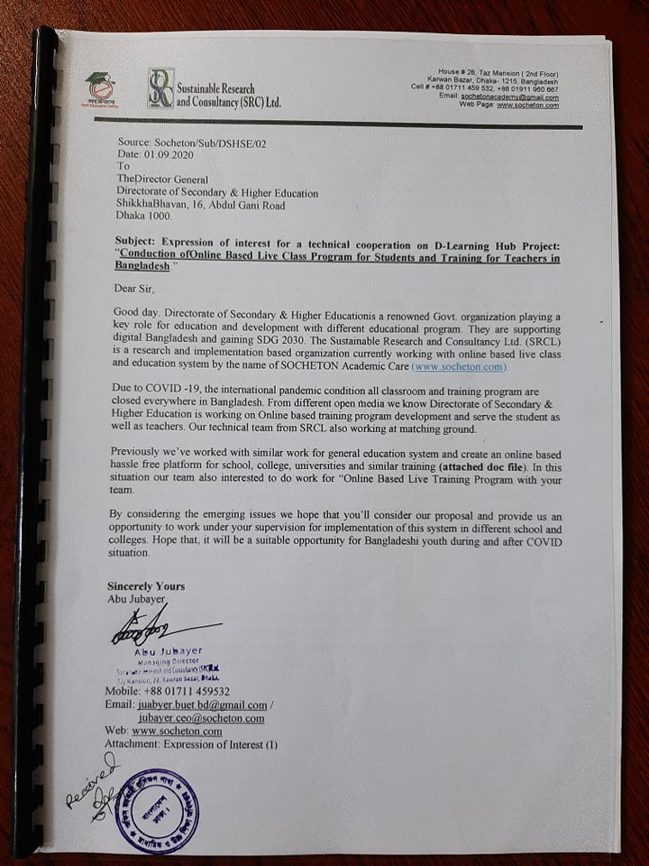
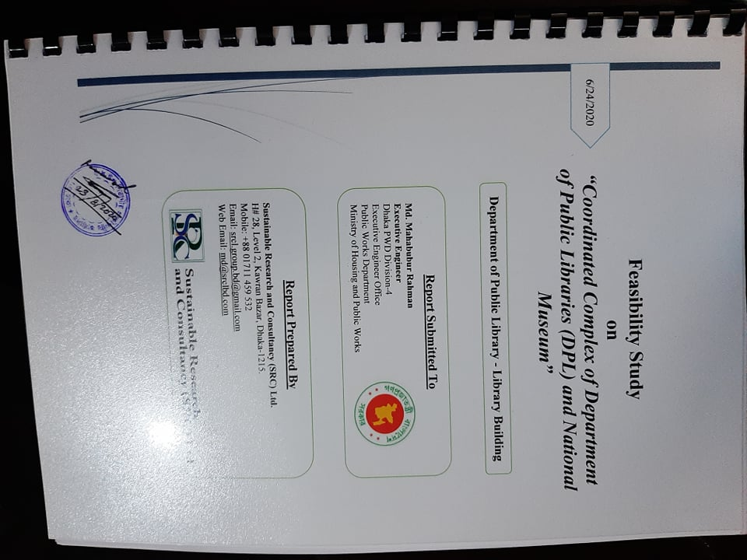
Some Running Projects

Slide 21
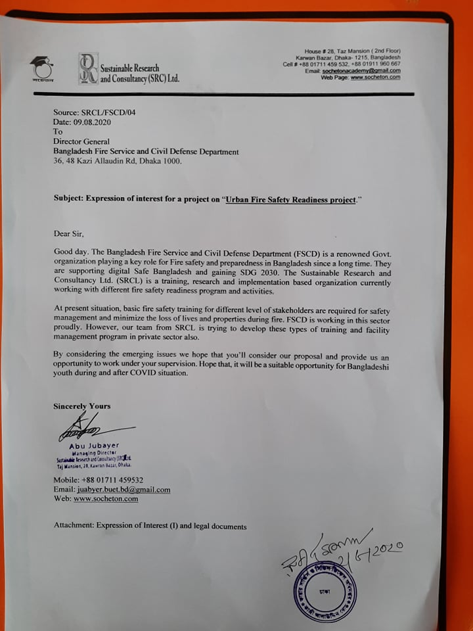
Continuing

Slide 22
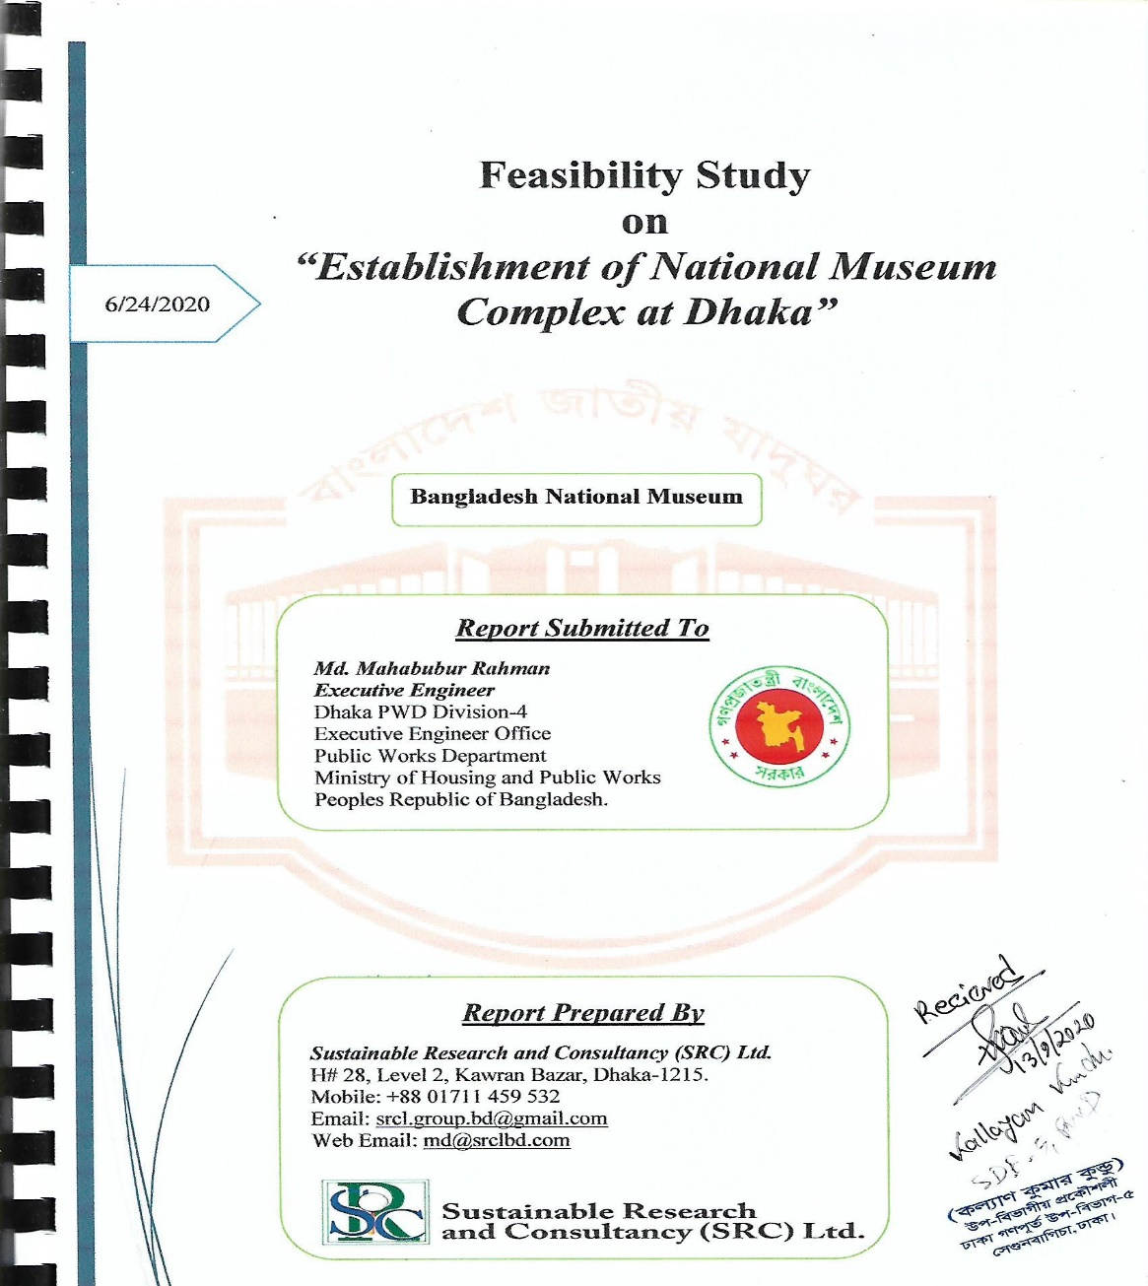

Slide 23
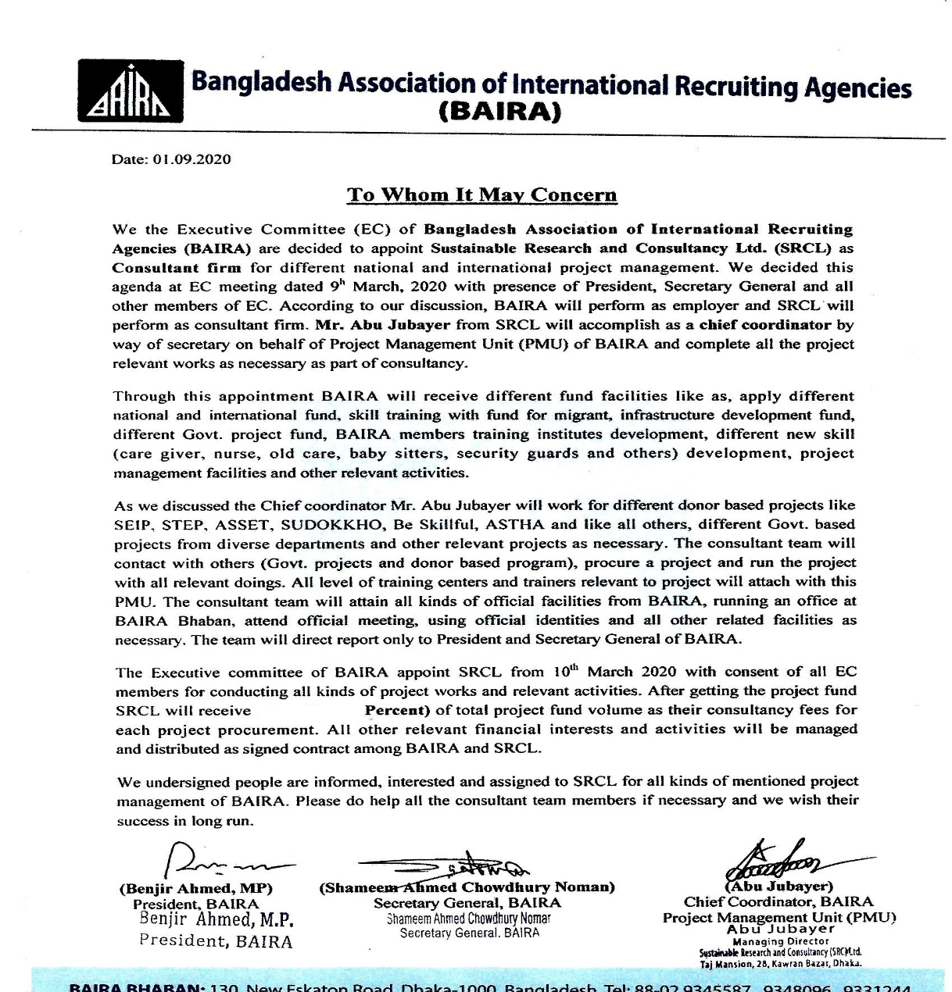

Slide 24
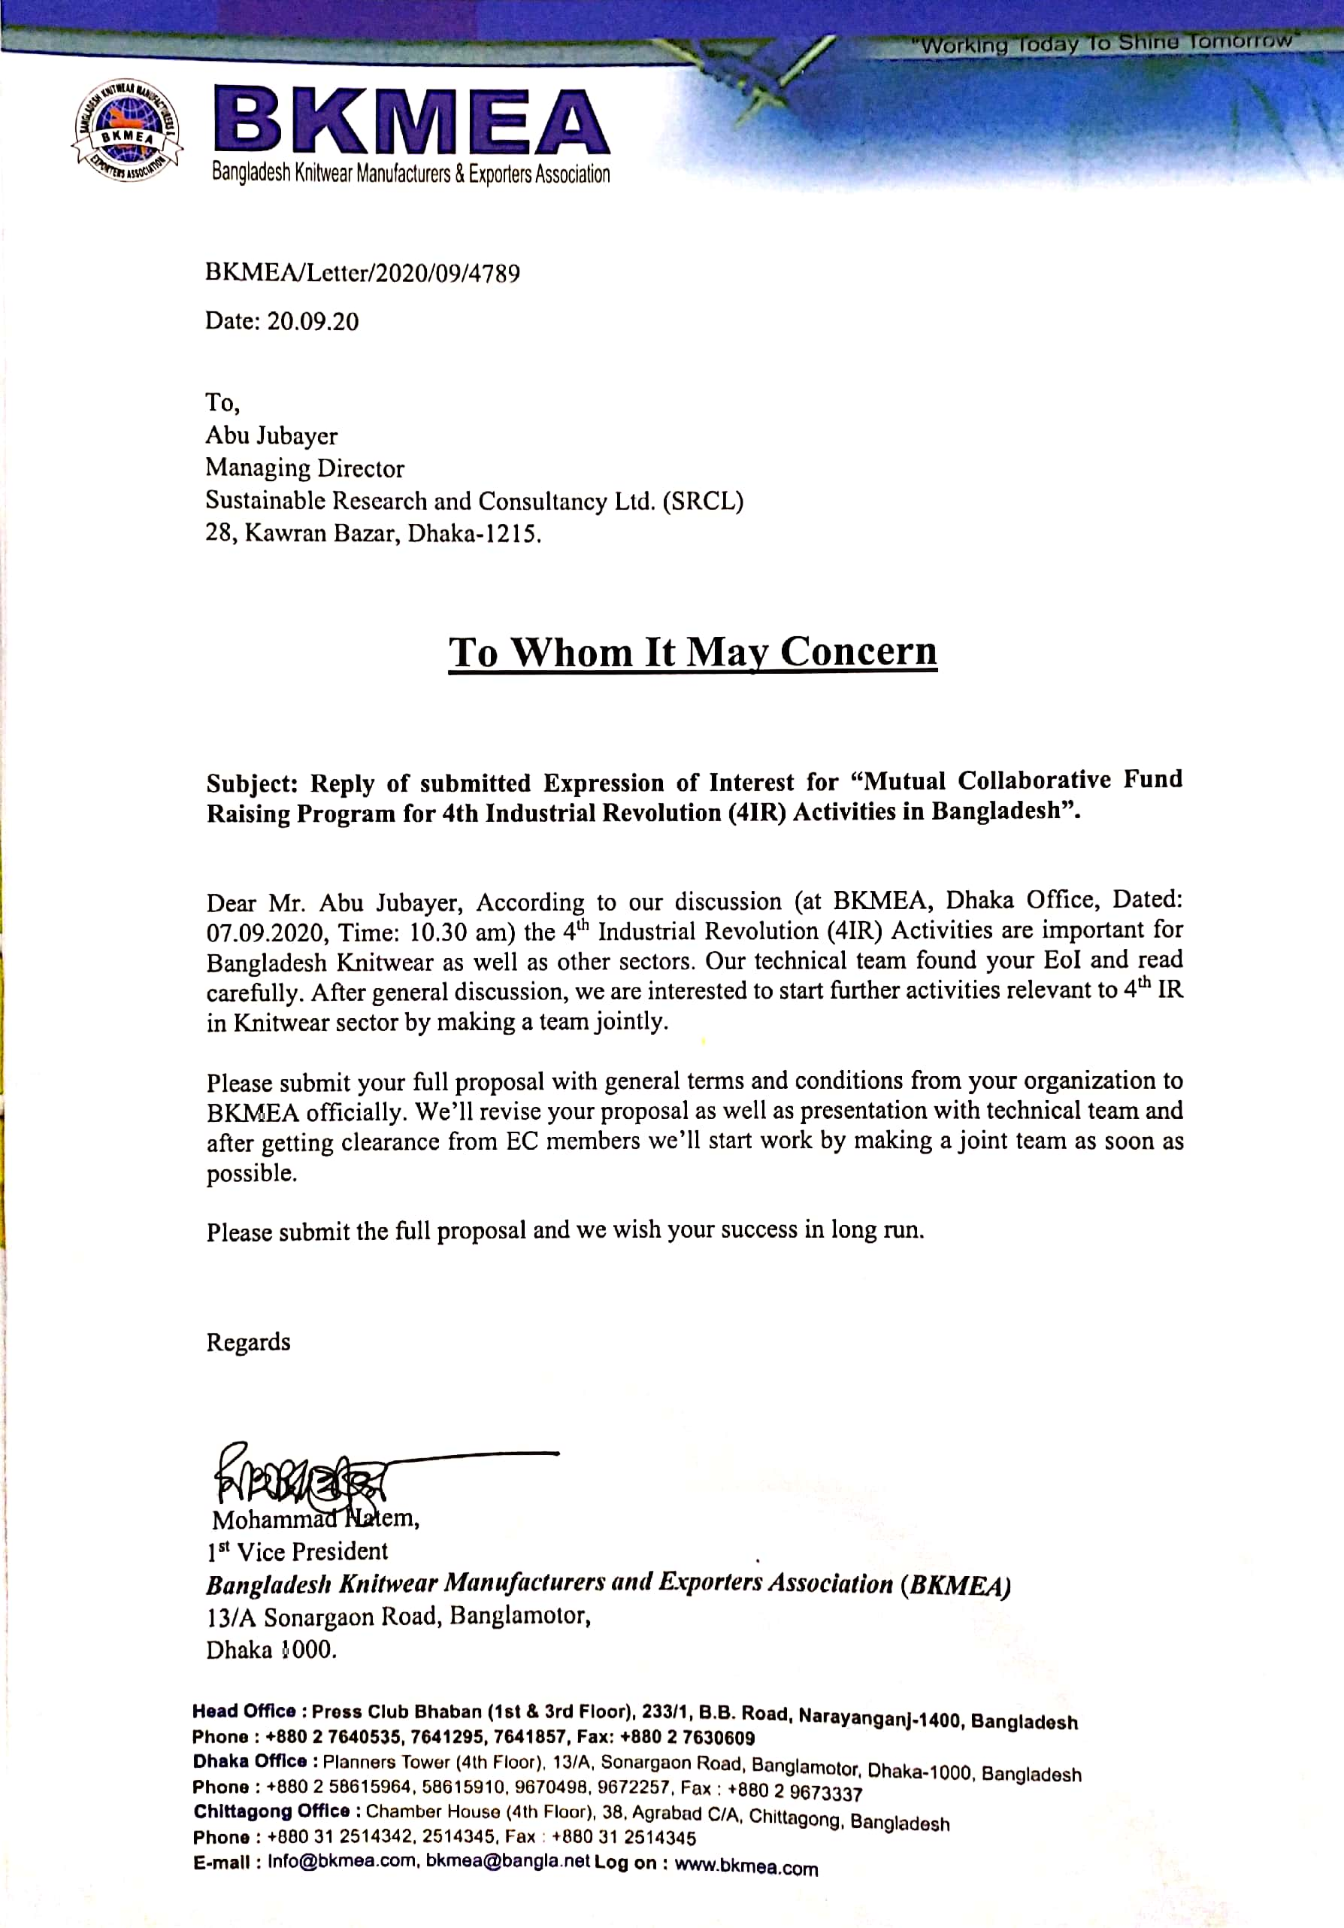

Slide 25
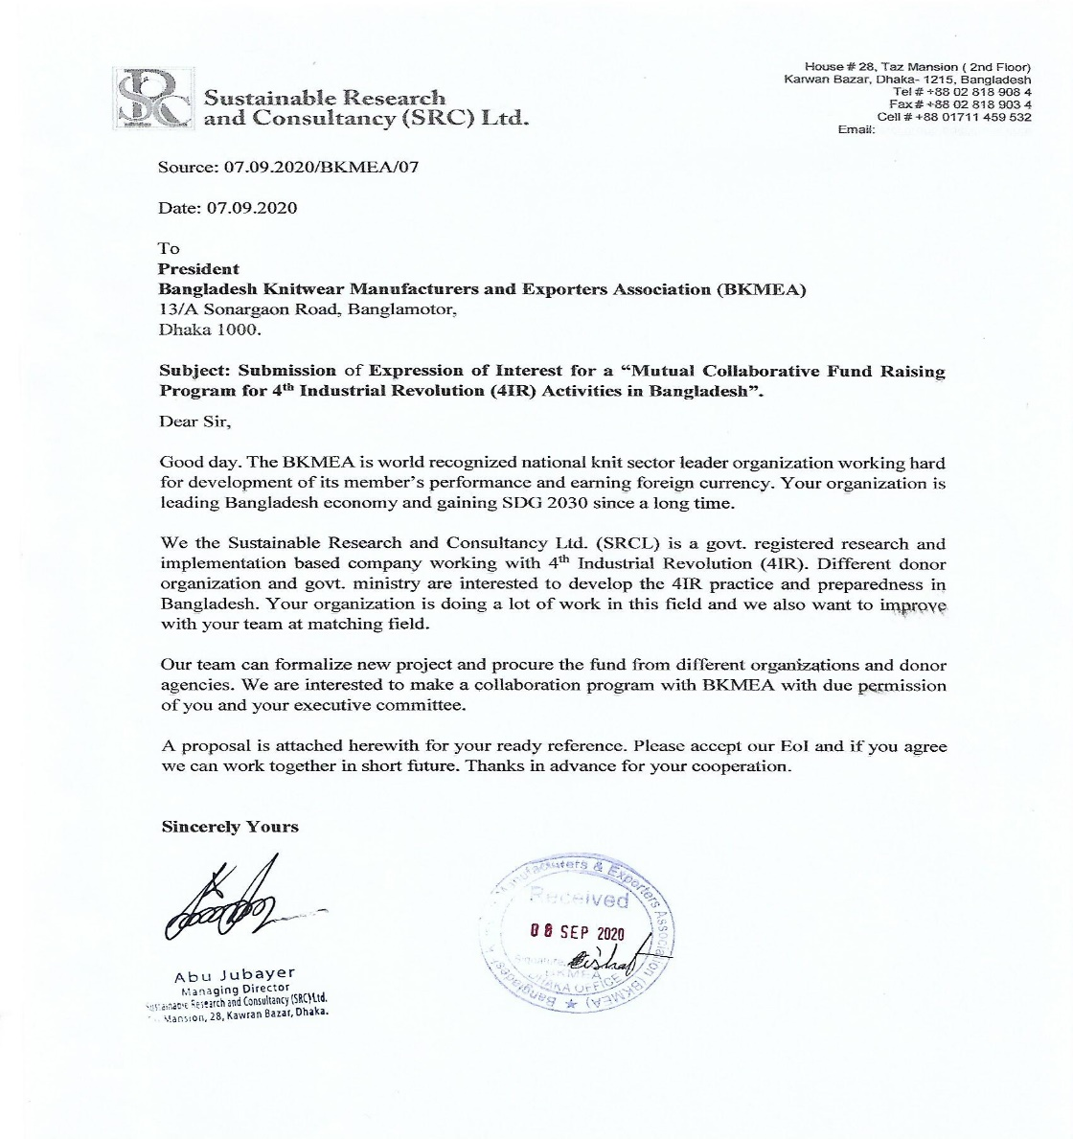
Continuing

Slide 26
Collaboration Point
Trade Organization (TO)
SRCL
New Projects for Future

